Slide 1
Building a Home Hacking Lab for Testing and Fun

Slide 2
$ whoami
Jimmy Lloyd
Principal Security Analyst/Penetration Tester at Bank of New York Mellon
Father of 3
DevSecOps and Security Automation enthusiast
@jacoll on twitter
https://github.com/jaconll12

Slide 3
Cyber Security PSA
Humility goes a long way
Imposter Syndrome is a real thing
Don’t let arrogance or feeling inadequate consume you
Everyone has some value to add no matter how novice you are.
“A true genius admits that he/she knows nothing.” ― Albert Einstein
“There is nothing noble in being superior to your fellow man; true nobility is being superior to your former self.” ― Ernest Hemingway

Slide 4

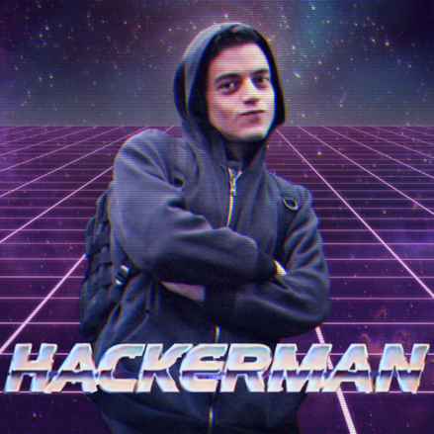
Getting started in IT/Cyber Security
What is the best way to learn anything in IT?
Play – Break — Fix – Try again
The same thought process works for IT Security

Slide 5
Why a home lab is important
So you you want to get started in learning, what is your first step
1. Download and install Kali Linux …..
2. Now what
Hack your neighbors?
Hack your work systems?
Seach Shodan for vulnerable systems to attack?

Slide 6
Cyber Security Related Laws
1974 Privacy Act
Electronic Communications Privacy Act (ECPA) 1986
Computer Fraud And Abuse Act (CFAA)
2011 Cyber Intelligence Sharing And Protection Act (CISPA)
2012 Children’s Online Privacy Protection Act (COPPA)
And the list goes on ….

Slide 7


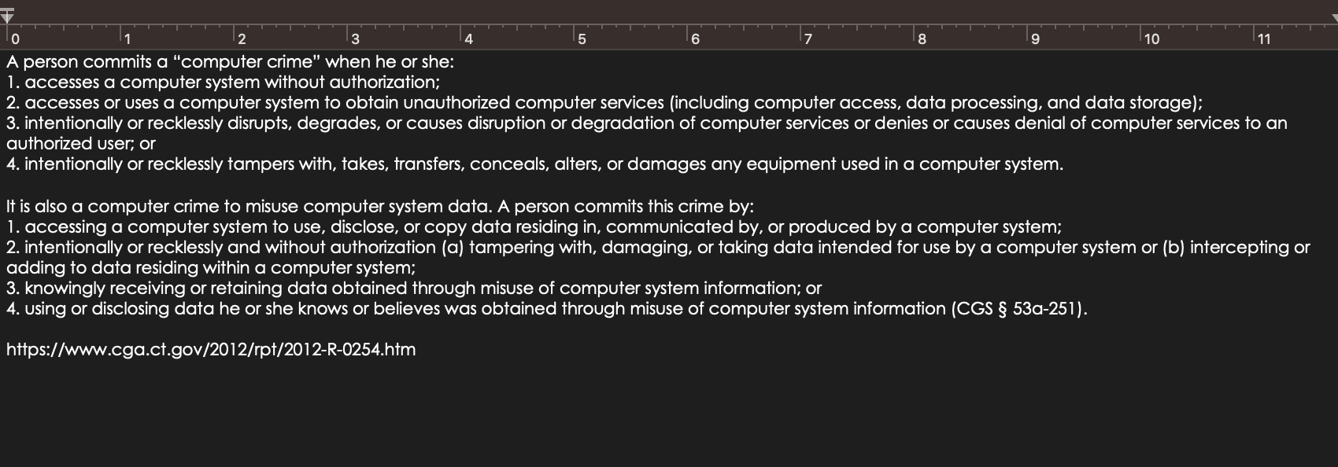
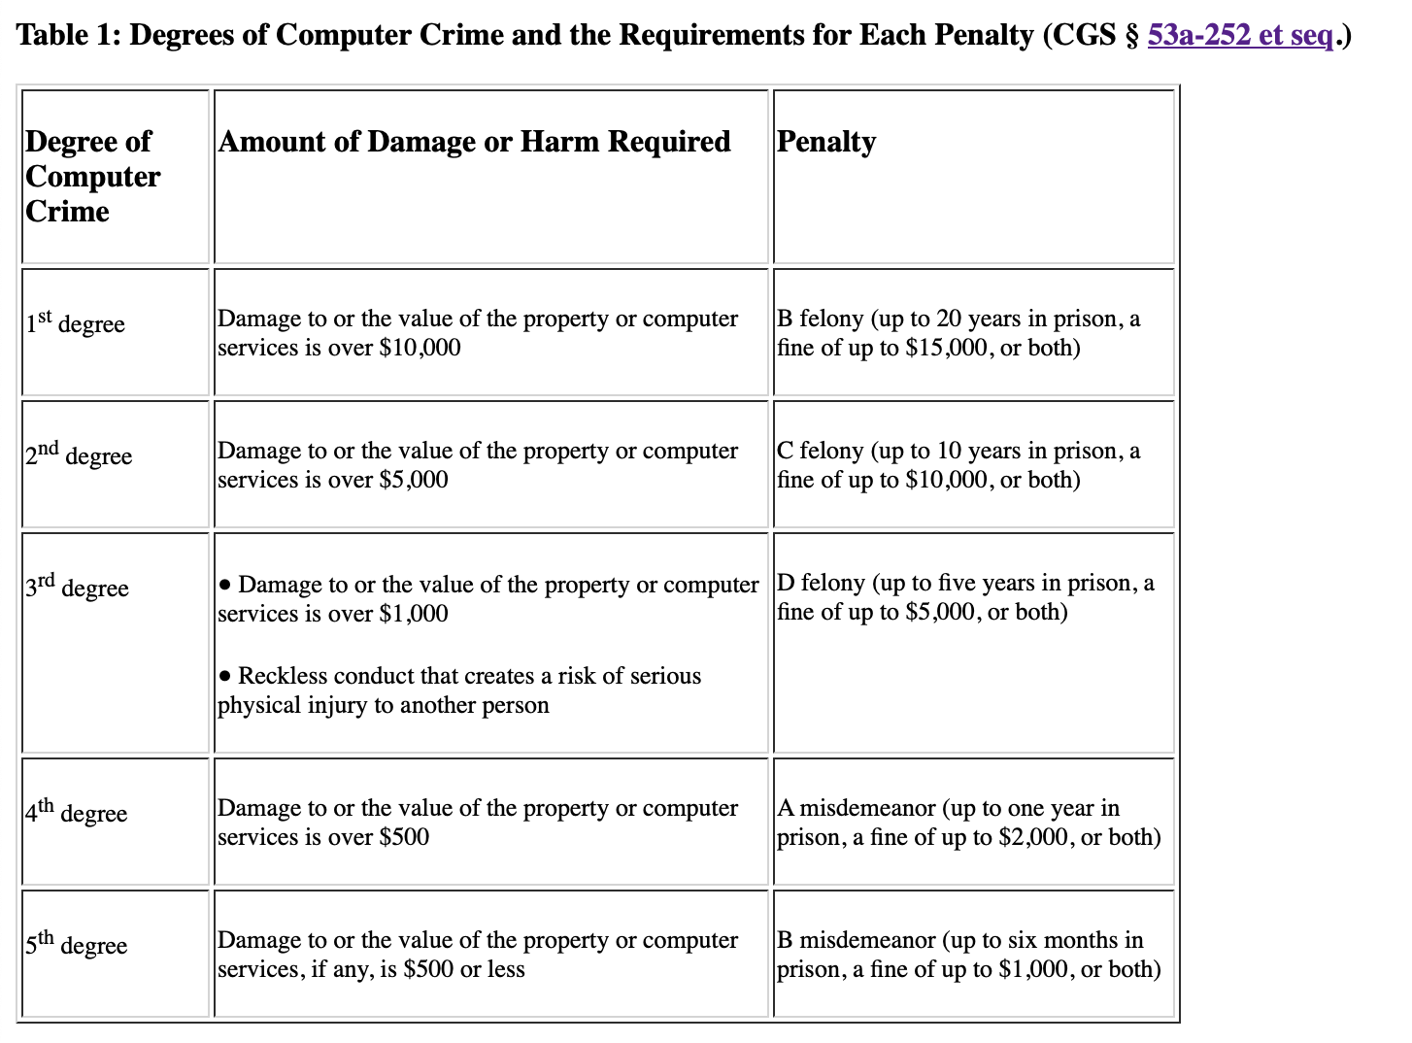



Cyber Crime

Slide 8
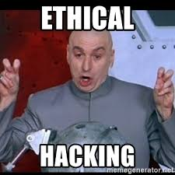
“Ethical Hacking”
Hacking is not a crime, hacking for malicious intent is.
“... ethical hacking is to evaluate the security of and identify vulnerabilities in systems, networks or system infrastructure. It includes finding and attempting to exploit any vulnerabilities to determine whether unauthorized access or other malicious activities are possible.”
https://searchsecurity.techtarget.com/definition/ethical-hacker

Slide 9
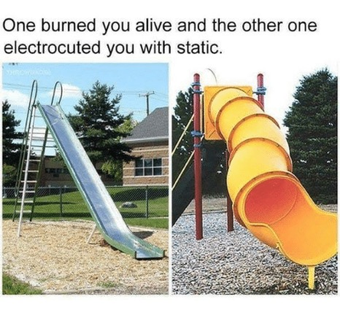
Why a home hacking lab is fun
Virtual Playground
Hands on approach to learning
Hacking is a a lot of fun

Slide 10
Additional Benefits of a Home Lab
Mimic real-world environments
Best way to learn about a technology is to build it yourself
Test new toolsets

Slide 11
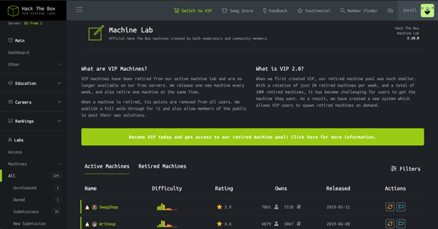
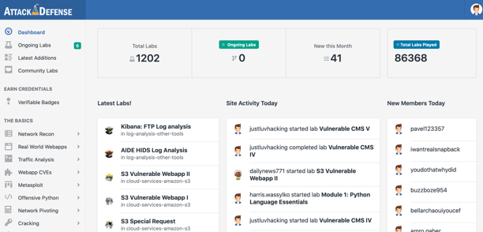
100% Online Options
HacktheBox
Has a paid and a free option
https://www.hackthebox.eu/home/machines
Attack Defense
Has a cost associated but the labs are very comprehensive
https://www.attackdefense.com
Other Options
https://www.hackthissite.org
https://www.enigmagroup.org

Slide 12
Now let's build your home hacking lab…

Slide 13

Steps to Building your Lab
Plan your focus
Design a plan
Segment your lab network
Install/Purchase the tools you need
Research …

Slide 14
Information OVERLOAD
https://www.amanhardikar.com/mindmaps/Practice.html

Slide 15

Different options for your lab
Bare Metal
Cloud
Virtualization

Slide 16
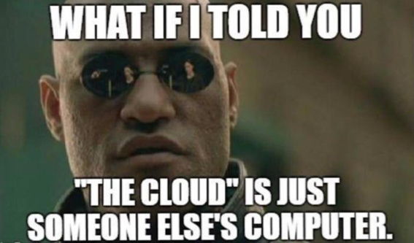
Cloud vs Physical
The Cloud allows you to spin up and configure systems/images very quickly
Cloud Options
AWS
GCS
Microsoft Azure
VPS Services
Physical (In House)

Slide 17
Pros/Cons of Cloud
Pros
Speed
Agility
Cost
Cons
Cost
Networking
Traffic Flow

Slide 18
Cloud Demo

Slide 19
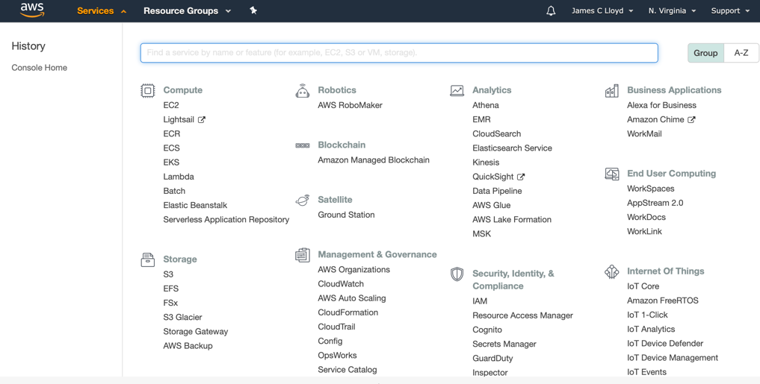
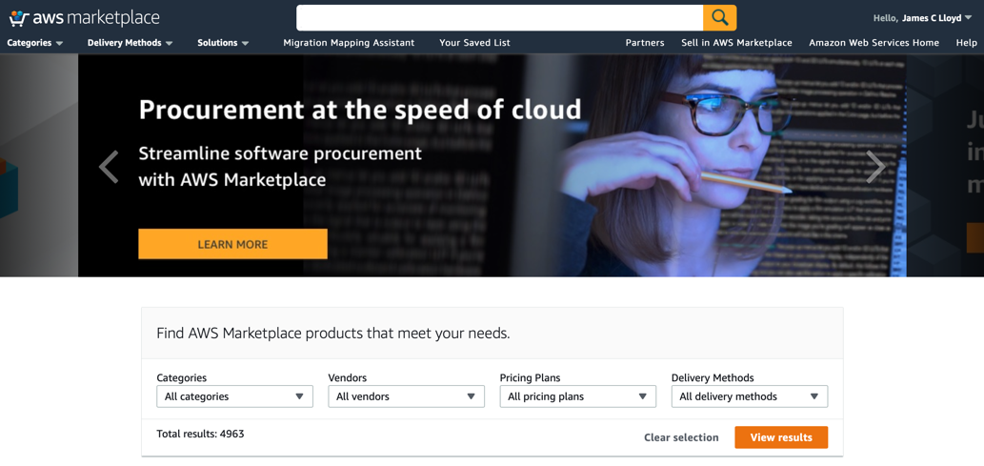
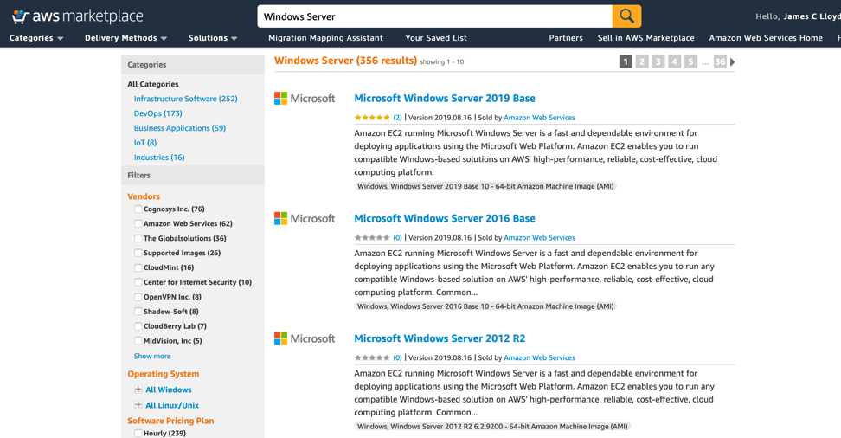
Amazon Web Services

Slide 20
Virtualization

Slide 21
Full Operating System Virtualization Software
VMWare Workstation/Fusion
VMWare Player
Oracle Virtual Box
Parallels (MacOS Only)
ESXi – Full Hypervisor

Slide 22
Pros and Cons of VMs
Pros
Highly Configurable
Expandable
Full Operation System Level functionality
Able to Limit availability
Snapshotting
Cons
Resource intensive
Longer to setup and configure

Slide 23
Windows 10 Subsystem for Linux
Windows Subsystem for Linux, or WSL, is a feature-set in Windows 10 that allows Linux programs to run natively. Its not a true virtual machine, but a virtual environment
“Our top requests from the WSL community have been to increase the file system performance, and make more apps work inside of WSL (i.e: introduce better system call compatibility). We have heard your feedback, and are glad to announce that WSL 2 helps solve these issues. WSL 2 is a new version of the architecture that powers the Windows Subsystem for Linux to run ELF64 Linux binaries on Windows. This new architecture changes how these Linux binaries interact with Windows and your computer’s hardware, but still provides the same user experience as in WSL 1 (the current widely available version). Individual Linux distros can be run either as a WSL 1 distro, or as a WSL 2 distro, can be upgraded or downgraded at any time, and you can run WSL 1 and WSL 2 distros side by side. WSL 2 uses an entirely new architecture that uses a real Linux kernel.”
https://devblogs.microsoft.com/commandline/announcing-wsl-2/

Slide 24
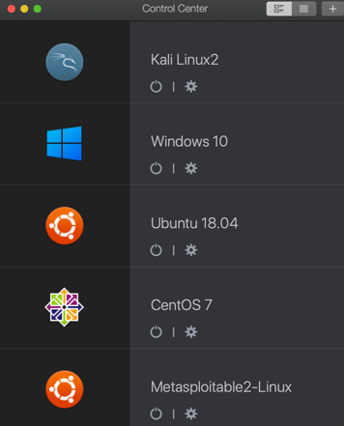
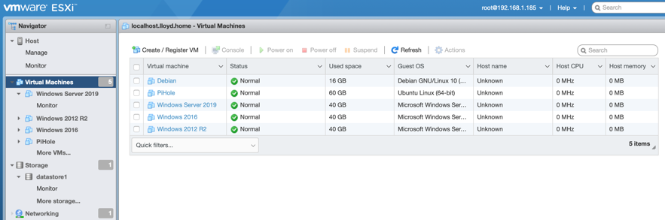
My Current Local VM Setup

Slide 25
Metasploitable
Vulnerable Operation System Image
Build by Offensive Security
A test environment provides a secure place to perform penetration testing and security research. For your test environment, you need a Metasploit instance that can access a vulnerable target. The following sections describe the requirements and instructions for setting up a vulnerable target.
https://metasploit.help.rapid7.com/docs/metasploitable-2

Slide 26
What is Docker?
Docker is a tool designed to make it easier to create, deploy, and run applications by using containers. Containers allow a developer to package up an application with all the parts it needs, such as libraries and other dependencies, and ship it all out as one package.
Think of Docker as virtualized applications/frameworks

Slide 27
Pros and Cons of Docker Containers
Pros
Someone has already done all the work for you
Very easy to deploy
Very easy to update
Cons
Docker images are not very easily customizable
Stability is sometimes an issue
Ability to limit availability
Trust in the source

Slide 28
Important Docker Commands
docker run – Runs a command in a new container.
docker start – Starts one or more stopped containers
docker stop – Stops one or more running containers
docker build – Builds an image form a Docker file
docker pull – Pulls an image or a repository from a registry
docker push – Pushes an image or a repository to a registry
docker export – Exports a container’s filesystem as a tar archive
docker search – Searches the Docker Hub for images
docker attach – Attaches to a running container
docker commit – Creates a new image from a container’s changes

Slide 29
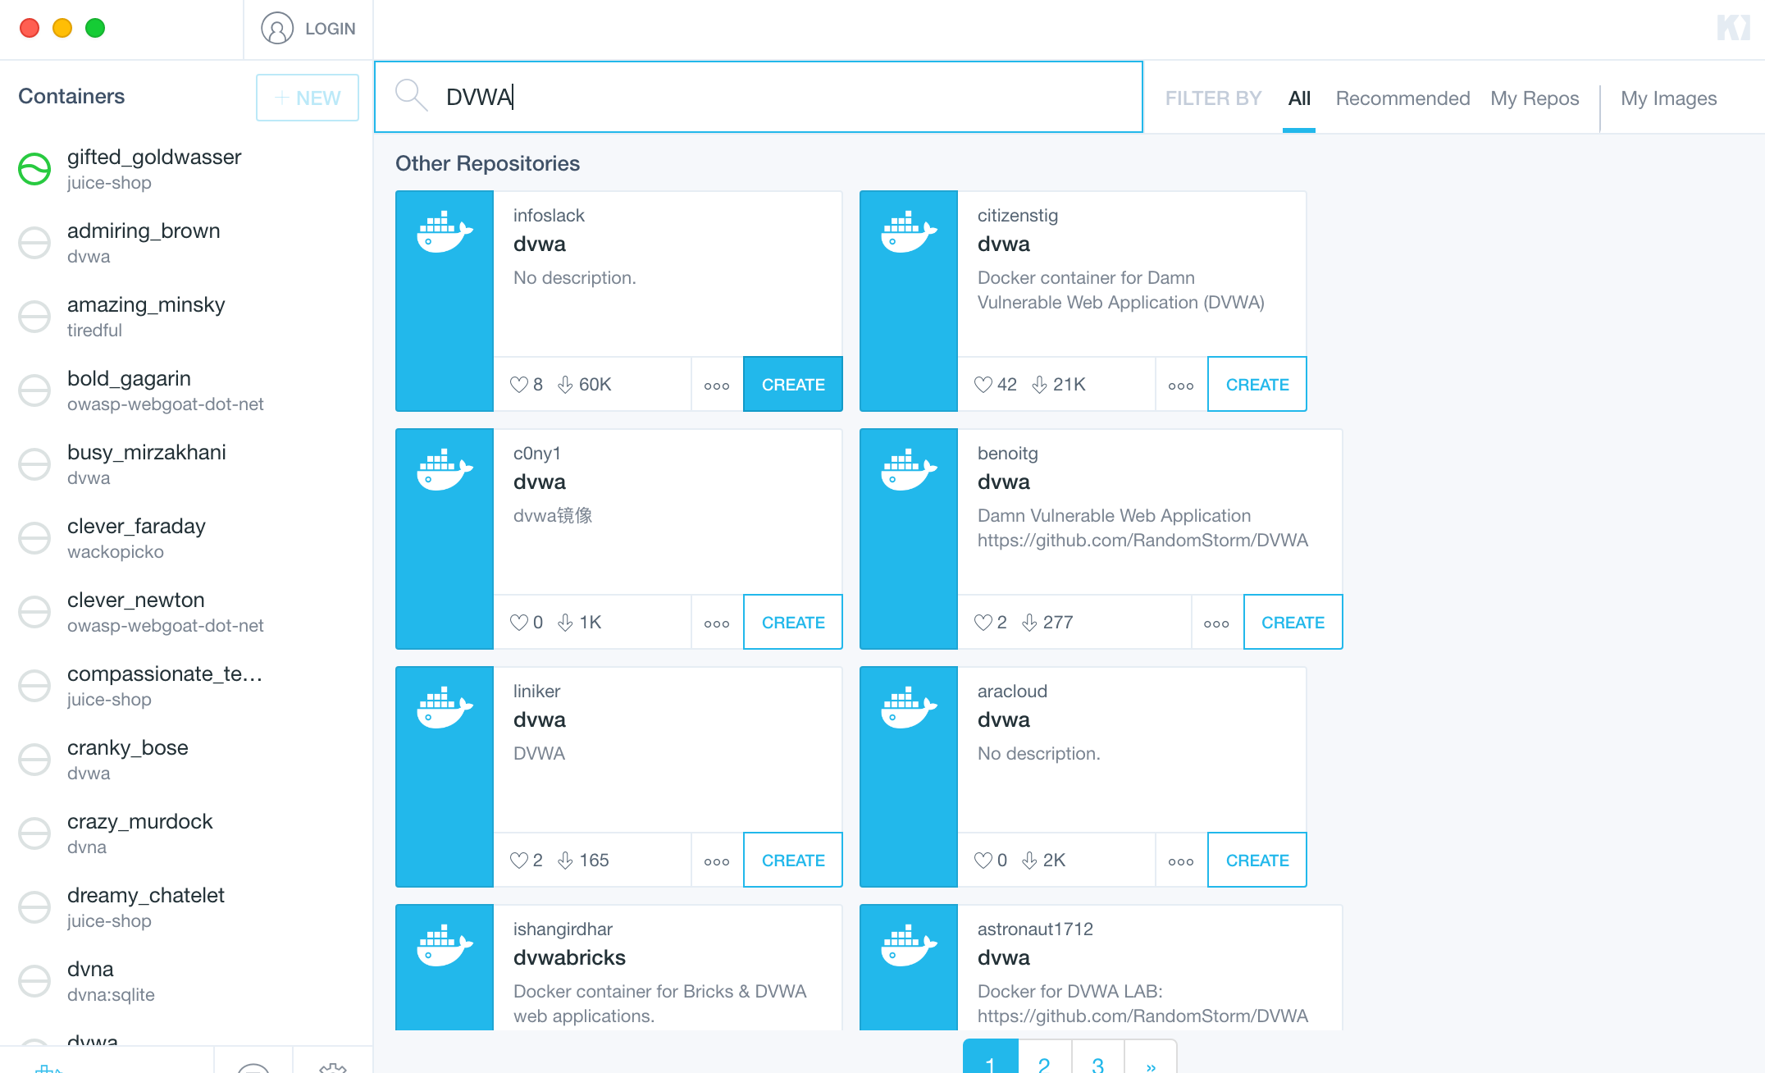
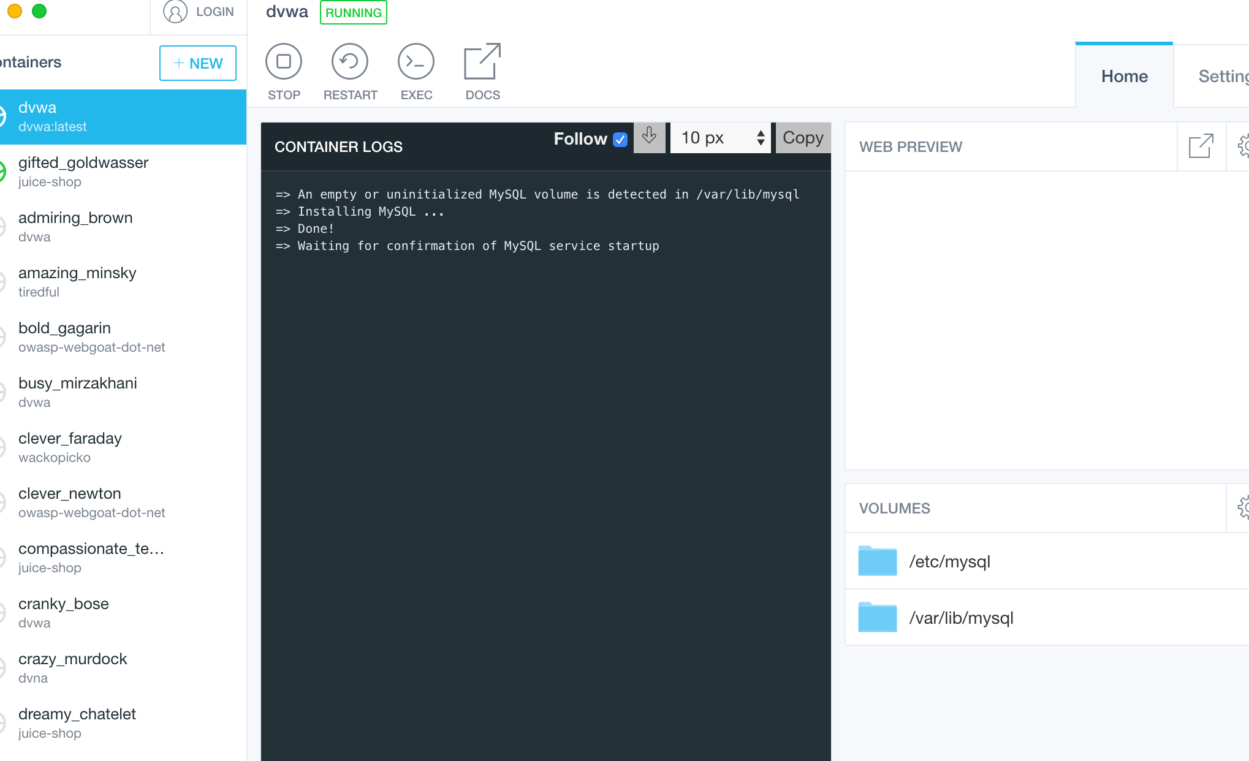
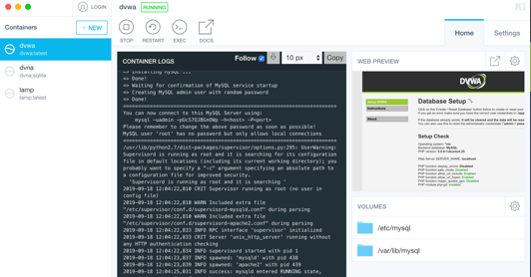
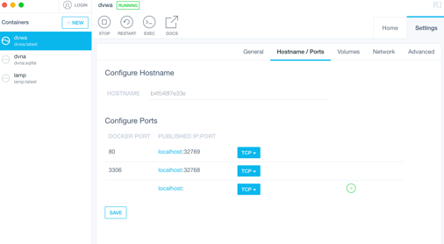
Kitematic
A GUI for Docker images.

Slide 30
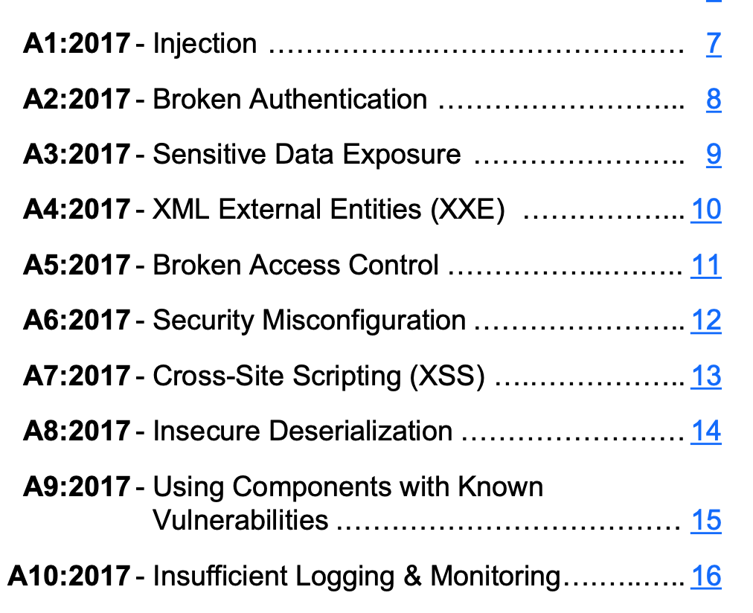
OWASP
“The Open Web Application Security Project (OWASP) is a 501(c)(3) worldwide not-for-profit charitable organization focused on improving the security of software. Our mission is to make software security visible, so that individuals and organizations are able to make informed decisions”
https://www.owasp.org/index.php/Main_Page
OWASP Top 10

Slide 31
OWASP Images
JuiceShop - NodeJS
WebGoat
Hackademic
LAMP
.Net

Slide 32
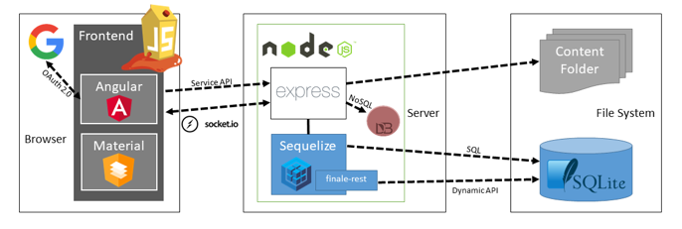
OWASP Juice Shop
OWASP Juice Shop is probably the most modern and sophisticated insecure web application! It can be used in security trainings, awareness demos, CTFs and as a guinea pig for security tools! Juice Shop encompasses vulnerabilities from the entire OWASP Top Ten along with many other security flaws found in real-world applications.
Juice Shop is written in Node.js, Express and Angular.

Slide 33
JuiceShop Demo

Slide 34
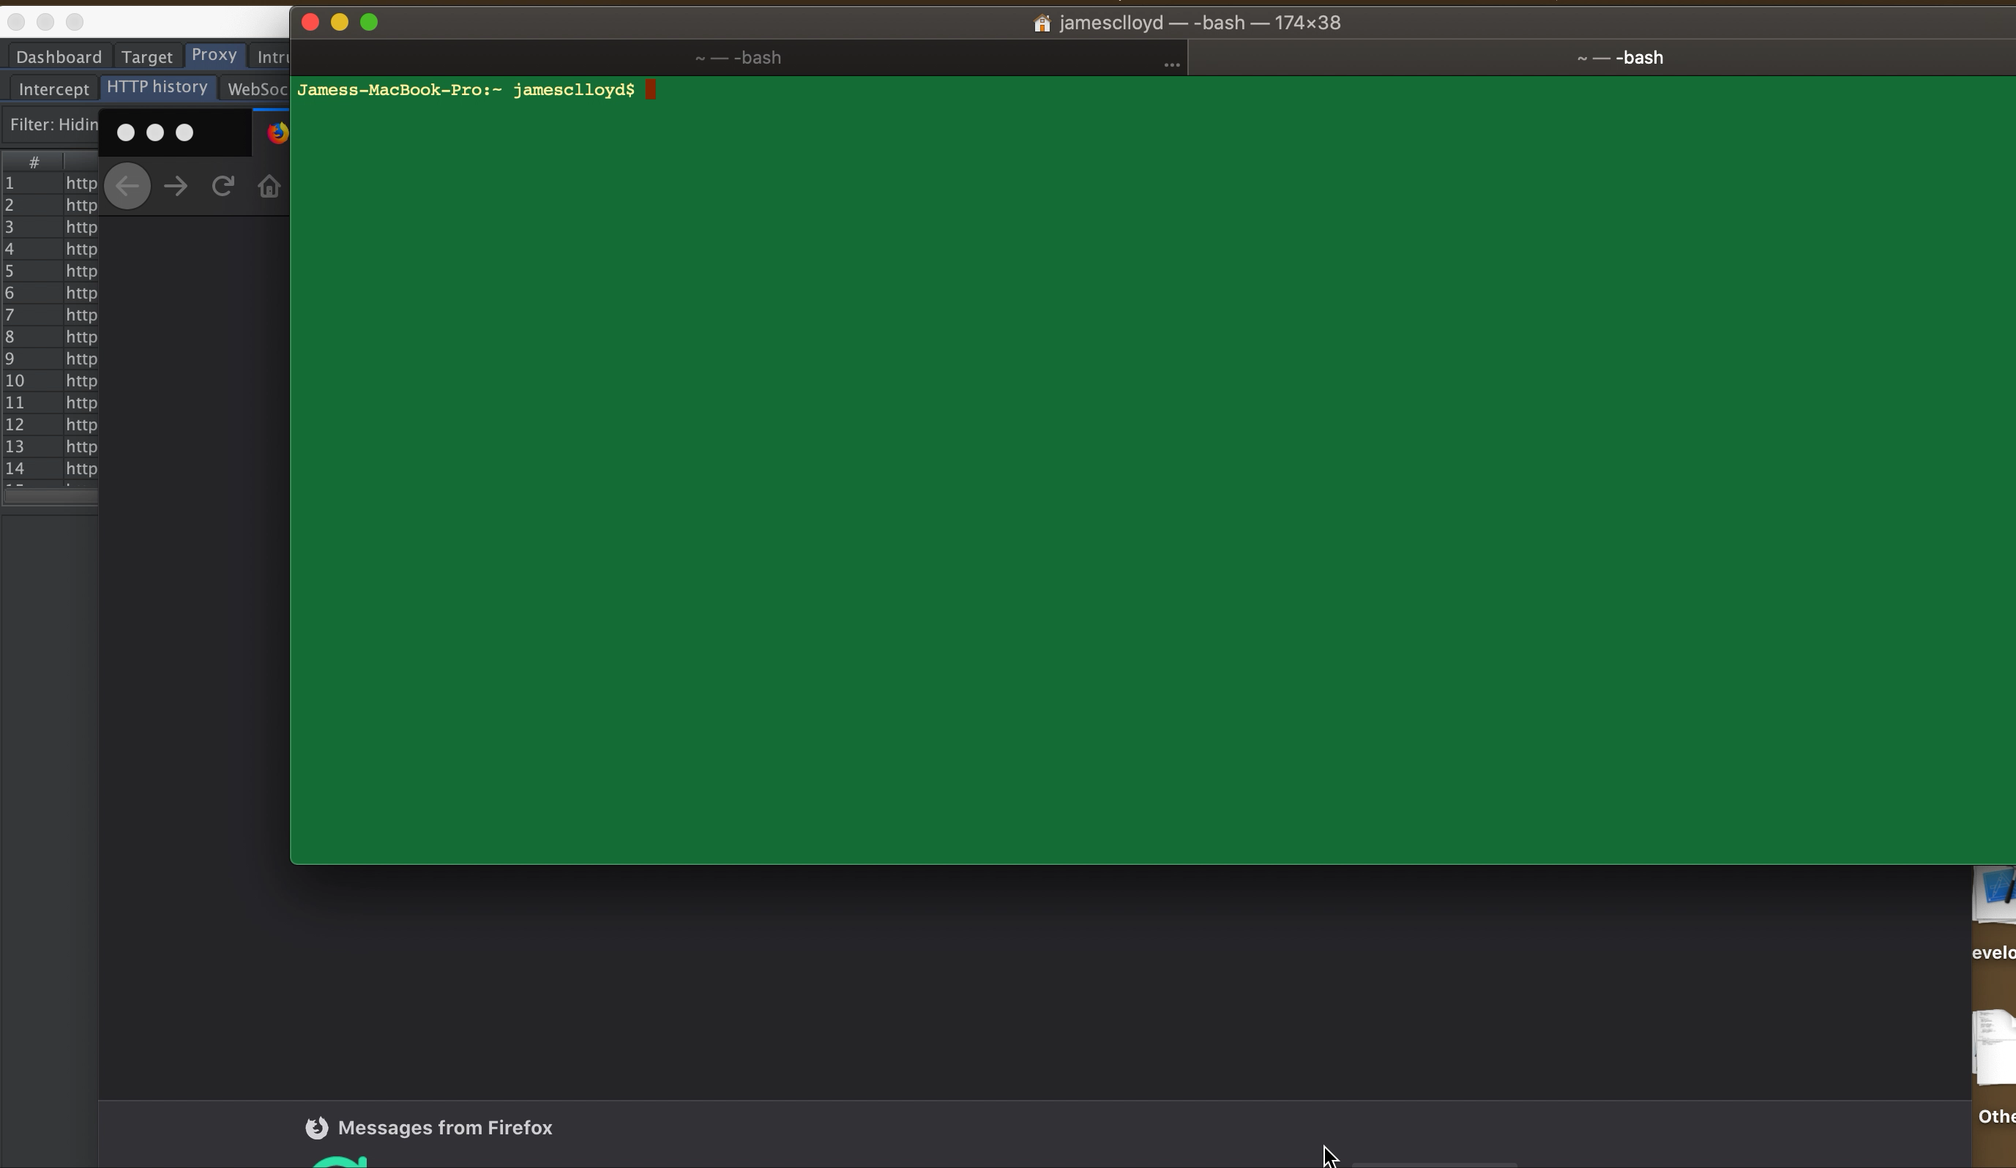

Slide 35
Current Setup
Current Docker images running locally
Damn Vulnerable Web App (DVWA)
OWASP JuiceShop
OWASP WebGoat.NET
Tiredful API
WackoPickto
Current Virtual Machines
Kali Linux
Debian 10
Ubuntu
Windows 10
Metasploitable
Windows Server 2012 R2

Slide 36




Current Lab Demo

Slide 37
Demo

Slide 38
Why This Setup Works for Me
I can to test from my host
Home Brew for mac
I can also test from the KALI VM
Using Docker + Remote/Local VMs allows diversity

Slide 39
Past interactions of my setup
Single Windows client (7/8/10) on old laptop
DISA STIGged Windows Image
Any Operating System could get for free
Couple Raspberry Pis

Slide 40
Past Issues
Resources
Time
Patience

Slide 41
Future Ideas
ESXi Server hosting most full VM images
Build completely “Cyber Range” in my home
Build complete Windows Active Directory domain with clients, IIS/.Net web applications, and AD Federated Services
Build custom vulnerable web applications (Apache, NGINX)
Jenkins CICD Pipeline
Automate deployment with tools like Puppet and Ansible

Slide 42
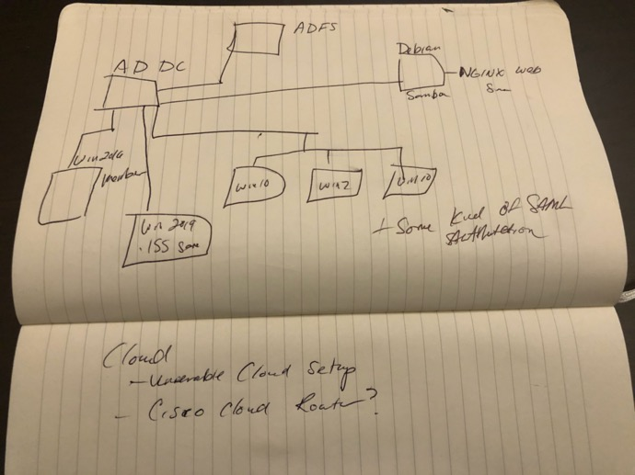
Future Logical Diagram

Slide 43
Real World Testing Scenarios
CyAn
Automated web app vulnerability scanner
https://github.com/jaconll12/CyAn
Needed a vulnerable web app to test my code
Enter Docker images
Exploit development
Bug Hunting
Training

Slide 44

DoD CyberRange and CyberFlag

Slide 45
USCyberCommand CyberFlag
Department of Defense CyberFlag Exercise
Blue Force
Red Force (OpFor)
White Cell
CyberFlag’s goal is to mimic real worth threats/APT and train defenders on what to look for

Slide 46
DoD Cyber Range and DISA MiniFlag
DISA ”MiniFlag” CyberFlag Prep
Full featured VM environment
Capable of hosting hundred of guest OS machines
Capable of importing almost any toolset
Defender Tools
Red Team Injects
My involvement
Build Red Team injects
Developed training plan and exercise flow

Slide 47
What I Learned from CyberFlag and the CyberRange
Having a complete and flexible testing environment is imperative for any profession, especially CyberSec
Planning is Key
You can create a smaller scale CyberRange at your home …

Slide 48

Final Comments
You will break EVERYTHING
You will make mistakes and screw up … that’s ok that’s why you are doing this in a lab
You will learn more than you ever could reading books
Start Small, then build up….
SEGMENT your lab network

Slide 49

Summary
An in-home lab is important for learning and growing
Its better than going to jail
You do not need a lot of money or experience to get started
Cloud, Physical, VM, or Docker
Document, document, document
Build upon your setup
Give back to the community
Have some fun

Slide 50
References
https://www.microsoft.com/en-us/evalcenter/evaluate-windows-server-2016?filetype=ISO
https://www.offensive-security.com/metasploit-unleashed/requirements/
https://afourtech.com/guide-docker-commands-examples/

